Slide 1
Lesson 9
Chapter 20: Entropy and the second law of thermodynamics
20-2 Entropy in the Real World: Engines
Heat Engine: A heat engine, or more simply, an engine, is a device that extracts energy from its environment in the form of heat and does useful work. At the heart of every engine is a working substance.
Carnot Engine: Although an ideal gas does not exist, any real gas approaches ideal behavior if its density is low enough. Similarly, we can study real engines by analyzing the behavior of an ideal engine.
“An ideal engine where all processes are reversible and no wasteful energy transfers occur due to, say, friction and turbulence”.

Slide 2
Schematic diagram of a Carnot Engine:
We shall focus on a particular ideal engine called a Carnot engine after the French scientist and engineer N. L. Sadi Carnot (pronounced “cah-no”),who first proposed the engine’s concept in 1824.This ideal engine turns out to be the best (in principle) at using energy as heat to do useful work. Surprisingly, Carnot was able to analyze the performance of this engine before the first law of thermodynamics and the concept of entropy had been discovered.
$pV$ plot of the Carnot cycle:
If we place the cylinder in contact with the high temperature reservoir at temperature $T_{H}$, heat $Q_{H}$ is transferred to the working substance from this reservoir as the gas undergoes an isothermal expansion from volume $V_{a}$ to volume $V_{b}$.
Similarly, with the working substance in contact with the low-temperature reservoir at temperature $T_{L}$, heat $Q_{L}$ is transferred from the working substance to the low-temperature reservoir as the gas undergoes an isothermal compression from volume${ V}_{c}$ to volume $V_{d}$ .
Thus the heat transfers to or from the working substance only during the isothermal processes $ab$ and $cd$.

Slide 3
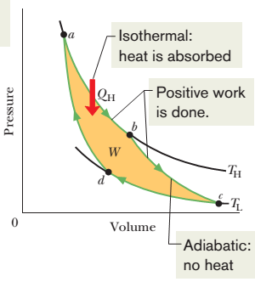
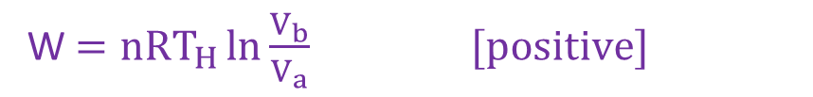
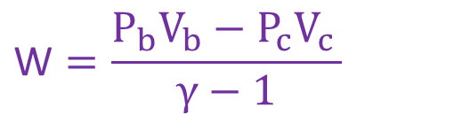
Isothermal expansion at constant T_{H} from a to b states:
P_{a}
Adiabatic expansion from b to c states:
P_{b}
P_{b}
V_{a}
V_{b}
P_{c}
Heat Q_{H} is absorbed by the working substance.
V_{c}
V_{b}
Pressure decreases from P_{a} to P_{b}
Heat Q is zero.
Volume increases from V_{a} to V_{b}
Pressure decreases from P_{b} to P_{c}
W $=nRT_{H}\ln{\frac{V_{b}}{V_{a}} [positive] }$
Volume increases from V_{b} to V_{c}
During the processes ab and bc, the working substance is expanding and thus doing positive work as it raises the weighted piston. This work is represented by the area under curve abc.
$$\text{W}=\frac{P_{b}V_{b}−P_{c}V_{c }}{γ−1}$$

Slide 4
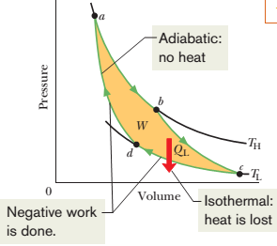
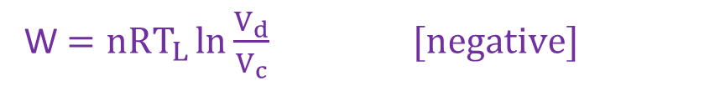

Isothermal compression at constant T_{L} from c to d states:
Heat Q_{L} is released.
Adiabatic compression from d to a states:
Heat Q is zero.
P_{a}
P_{d}
P_{c}
V_{d}
V_{c}
P_{d}
Pressure increases from P_{c} to P_{d}
V_{a}
V_{d}
Volume decreases from V_{c} to V_{d}
W $=nRT_{L}\ln{\frac{V_{d}}{V_{c}} [negative] }$
Pressure increases from P_{d} to P_{a}
During the processes cd and da, the working substance is being compressed, which means that it is doing negative work on its environment. This work is represented by the area under curve cda.
Volume decreases from V_{d} to V_{a}
$\text{W}=\frac{P_{d}V_{d}−P_{a}V_{a }}{γ−1}$ [negative]

Slide 5
Carnot cycle:
W = abcd area inside the curve [positive]
The net work per cycle is the difference between these two areas and is a positive quantity equal to the area enclosed by cycle abcda (yellow area).

Slide 6
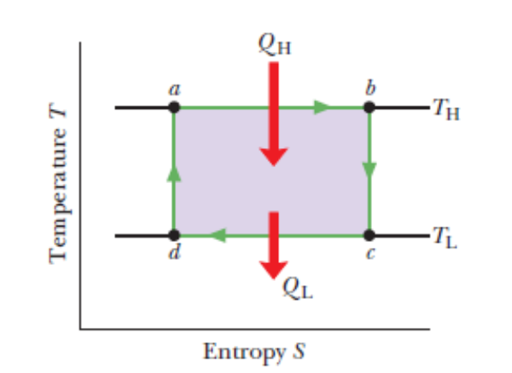
Carnot cycle on a temperature–entropy diagram
$$∆S=\frac{+Q}{T}$$
In the temperature–entropy $(T−S$) diagram the lettered points $a, b, c,$and $d$ there correspond to the lettered points in the $p−V$ diagram for the Carnot cycle.
$$∆S=0$$
The two horizontal lines in Fig. correspond to the two isothermal processes of the cycle. Process $ab$ is the isothermal expansion and process bc is the isothermal compression of the cycle.
$$∆S=\frac{−Q}{T}$$
As the working substance (reversibly) absorbs energy $Q_{H}$ as heat at constant temperature $T_{H}$ during the expansion, its entropy increases.
$$∆S=\frac{+Q}{T}$$
Similarly, during the isothermal compression $cd$, the working substance (reversibly) loses energy $Q_{L}$ as heat at constant temperature $T_{L}$, and its entropy decreases.
$$∆S=\frac{−Q}{T}$$
The two vertical lines correspond to the two adiabatic processes of the Carnot cycle. Because no energy is transferred as heat during the two processes (Q = 0), the entropy of the working substance is constant during them.
$$∆S=0$$

Slide 7





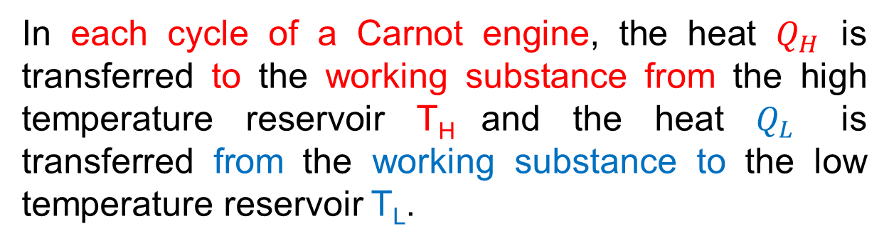

The Work:
In a Carnot engine, the working substance completes reversible cycles.
$$∆E_{int}=0$$
For a complete cycle of the working substance, the net internal energy change,
In each cycle of a Carnot engine, the heat $Q_{H}$ is transferred to the working substance from the high temperature reservoir T_{H} and the heat $Q_{L}$ is transferred from the working substance to the low temperature reservoir T_{L}.
So, the net heat transfer per cycle,
$$Q=\left|Q_{H}\right|−\left|Q_{L}\right|$$
The first law of thermodynamics for the Carnot cycle,
$$∆E_{int}=Q−W$$
$$0=Q−W$$
$$W=Q$$
$$W=\left|Q_{H}\right|−\left|Q_{L}\right|$$
This is the net work done by a Carnot engine during a cycle.

Slide 8

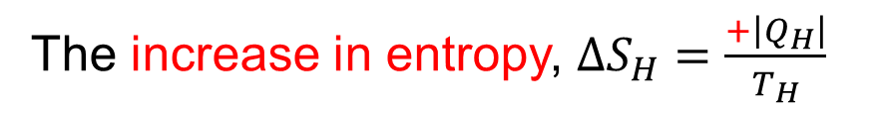

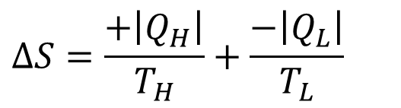
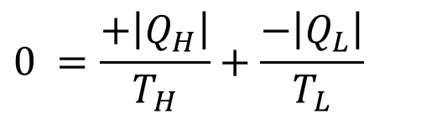



Entropy Changes:
There are two isothermal processes in each cycle of a Carnot engine.
During the isothermal expansion, the working substance absorbs heat $\left|Q_{H}\right|$ at temperature $T_{H}.$
The increase in entropy, $∆S_{H}=\frac{+\left|Q_{H}\right|}{T_{H}}$
Again during the isothermal compression, the working substance releases heat $\left|Q_{H}\right|$ at constant temperature $T_{L}$.
The decrease in entropy, $∆S_{L}=\frac{−\left|Q_{L}\right|}{T_{L}}$
For a complete cycle, $∆S=0$
Thus the net entropy change per cycle,
$$0 =\frac{+\left|Q_{H}\right|}{T_{H}}+\frac{−\left|Q_{L}\right|}{T_{L}}$$
$$∆S=∆S_{H}+∆S_{L}$$
$$∆S=\frac{+\left|Q_{H}\right|}{T_{H}}+\frac{−\left|Q_{L}\right|}{T_{L}}$$
$$\frac{\left|Q_{H}\right|}{T_{H}}=\frac{\left|Q_{L}\right|}{T_{L}}$$
$$\frac{\left|Q_{H}\right|}{\left|Q_{L}\right|}=\frac{T_{H}}{T_{L}}$$

Slide 9
Efficiency of a Carnot Engine:
Thermal efficiency of any engine is defined as,
$$ε=\frac{energy we get}{energy we provide}=\frac{\left|W\right|}{\left|Q_{H}\right|}$$
$$ε=\frac{\left|Q_{H}\right|−\left|Q_{L}\right|}{\left|Q_{H}\right|}$$
$ε=1−\frac{\left|Q_{L}\right|}{\left|Q_{H}\right|}$ [any engine]
$ε=1−\frac{T_{L}}{T_{H}}$ [Carnot engine]
[$T_{L}<T_{H}$]
Because $T_{L}<T_{H}$, the efficiency of Carnot engine is less than unity or less than 100%. Thus only a part of the extracted heat is available to do work and the rest is delivered to the low temperature reservoir.

Slide 10
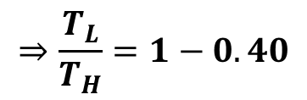


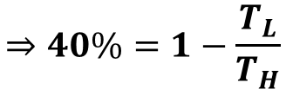
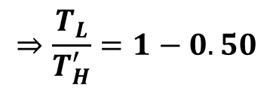
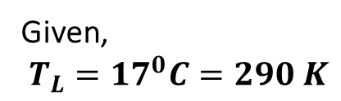


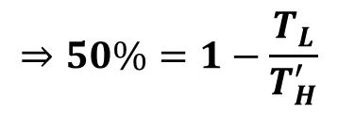


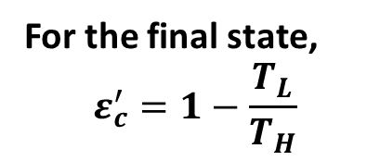



23. A Carnot engine whose low-temperature reservoir is at 17 ⁰C has an efficiency of 40%. By how much should the temperature of the high-temperature reservoir be increased to increase the efficiency to 50%?
Solution:
Given,
$$T_{L}={17}^{0}C=290 K$$
For the final state,
$$ε_{c}^{′}=1−\frac{T_{L}}{T_{H}}$$
So the increased temperature of the high temperature reservoir,
$$∆T_{H}=T_{H}^{′}−T_{H}$$
$$Initial efficiency, ε_{c}=40\%$$
$$Final efficiency, ε_{c}^{′}=50\%$$
$$⇒50\%=1−\frac{T_{L}}{T_{H}^{′}}$$
$$=(580−483.33) K$$
$$∆T_{H}=?$$
$$⇒\frac{T_{L}}{T_{H}^{′}}=1−0.50$$
$$=96.67 K$$
For the initial state,
$$ε_{c}=1−\frac{T_{L}}{T_{H}}$$
$$∴T_{H}^{′}=580 K$$
$$⇒40\%=1−\frac{T_{L}}{T_{H}}$$
$$⇒\frac{T_{L}}{T_{H}}=1−0.40$$
$$∴T_{H}=483.33 K$$

Slide 11



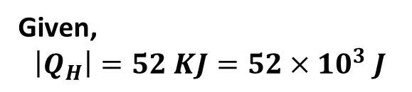
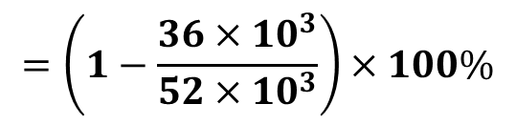

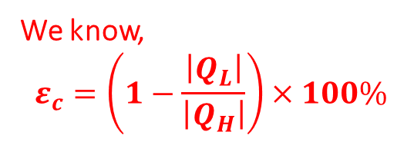


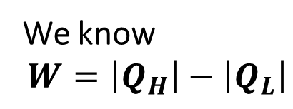
24. A Carnot engine absorbs 52 kJ as heat and exhausts 36 kJ as heat in each cycle. Calculate (a) the engine’s efficiency and (b) the work done per cycle in kilojoules.
Solution:
Given,
$$\left|Q_{H}\right|=52 KJ=52×{10}^{3} J$$
$$\left(b\right)W=?$$
$$\left|Q_{L}\right|=36 KJ=36×{10}^{3} J$$
We know
$$W=\left|Q_{H}\right|−\left|Q_{L}\right|$$
$${\left(a\right)ε}_{c}=?$$
We know,
$$ε_{c}=\left(1−\frac{\left|Q_{L}\right|}{\left|Q_{H}\right|}\right)×100\%$$
$$=52 KJ−36 KJ$$
$$=\left(1−\frac{36×{10}^{3}}{52×{10}^{3}}\right)×100\%$$
$$=16 KJ$$
$$=30.77 \%$$

Slide 12
Chapter 20: Entropy and the second law of thermodynamics
20-2 No Perfect Engines:
Inventors continually try to improve engine efficiency by reducing the energy Q_{L} that is “thrown away” during each cycle. The inventor’s dream is to produce the perfect engine, diagrammed in Fig, in which Q_{L} is reduced to zero and Q_{H} is converted completely into work.
Also, a perfect engine is only a dream: impossible requirements
$ε=1−\frac{T_{L}}{T_{H}}$ = $=1−\frac{0}{∞}$ = 1 = 100%
Instead, experience gives the following alternative version of the second law of thermodynamics, which says in short, there are no perfect engines:
“No series of processes is possible whose sole result is the transfer of energy as heat from a thermal reservoir and the complete conversion of this energy to work”.

Slide 13




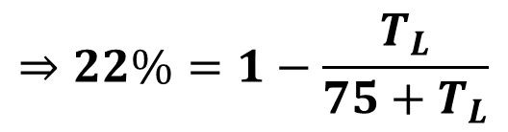

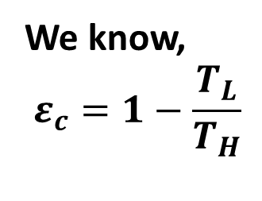
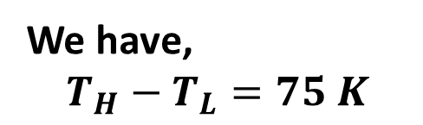
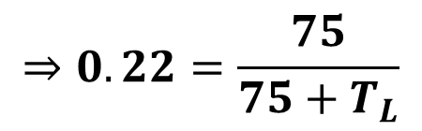

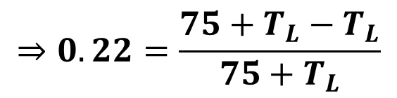

25. A Carnot engine has an efficiency of 22.0%. It operates between constant-temperature reservoirs differing in temperature by 75.0 C⁰. What is the temperature of the (a) lower-temperature and (b) higher-temperature reservoir?
$$⇒0.22=\frac{75}{75+T_{L}}$$
Given,
Efficiency, $ε_{c}=22.0\%=0.22$
Difference in temperature, $T_{H}−T_{L}={75}^{0}C=75 K$
$$⇒0.22(75+T_{L})=75$$
$${(T}_{H}+273)−{(T}_{L}+273)=75K$$
$$∴T_{L}=266 K$$
$$\left(a\right) T_{L}=?$$
$$\left(b\right){ T}_{H}= ?$$
We know,
$$ε_{c}=1−\frac{T_{L}}{T_{H}}$$
We have,
$$T_{H}−T_{L}=75 K$$
$$⇒22\%=1−\frac{T_{L}}{75+T_{L}}$$
$[as T_{H}=75+T_{L}$]
$$∴T_{H}=341 K$$
$$⇒0.22=\frac{75+T_{L}−T_{L}}{75+T_{L}}$$

Slide 14


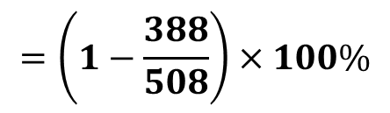

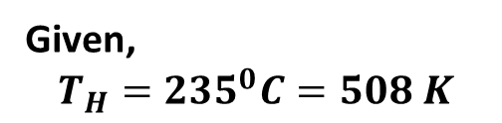
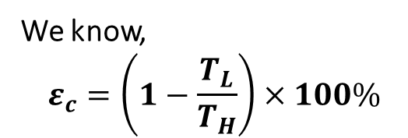


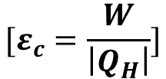

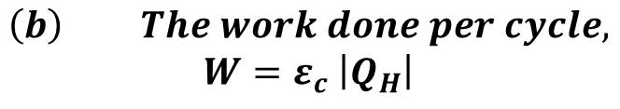
27. A Carnot engine operates between 235 ⁰C and 115 ⁰C, absorbing 6.30x10⁴ J per cycle at the higher temperature. (a) What is the efficiency of the engine? (b) How much work per cycle is this engine capable of performing?
Given,
$$T_{H}={235}^{0}C=508 K$$
$$T_{L}={115}^{0}C=388 K$$
$$\left(b\right) The work done per cycle,$$
$$W=ε_{c} \left|Q_{H}\right|$$
$$[ε_{c}=\frac{W}{\left|Q_{H}\right|}]$$
$$Q_{H}=6.3×{10}^{4} J$$
$${\left(a\right) ε}_{c}=?$$
$$=23.62\% ×(6.3×{10}^{4})$$
We know,
$$ε_{c}=\left(1−\frac{T_{L}}{T_{H}}\right)×100\%$$
$$=1.48×{10}^{4} J$$
$$=\left(1−\frac{388}{508}\right)×100\%$$
$$=23.62\%$$

